Slide 1

Introduction to Genealogy
Tools, Tips, and Tricks

Slide 2
Start with what you know
Family names
Places
Dates
Need to date back to at least 1940 (most recent Census records available)

Slide 3
Start with what you know
Interview family members
Search through old photographs, papers, scrapbooks, etc.
See what’s already been done

Slide 4
Not everything is online
Websites and databases are great tools, but…
Only 30% of genealogical records are available online

Slide 5
Explore libraries and archives
Local public libraries
Historical societies
State archives
City/town clerks

Slide 6
Ancestry
Free to use at Concord Public Library
Available anytime the library is open
Available on library computers or on your own device via the library’s Wi-Fi

Slide 7
FamilySearch
Free to use at Concord Public Library or at home
Using FamilySearch at CPL will provide you with access to more records
Available anytime the library is open
Available on library computers or on your own device via the library’s Wi-Fi
Must create your own account

Slide 8
Think like a historian
Be critical
Be thorough
Document your findings
Cite your sources

Slide 9
Verify your research
We’re related to Charlemagne, George Washington, and the Kennedys!
Revisit, with an analytical eye, family lore
Be honest with your family history

Slide 10
Verify your research
Sources can have conflicting reports
Question the sources
Are they verifiable?
Trust the source closest to the date of the event

Slide 11
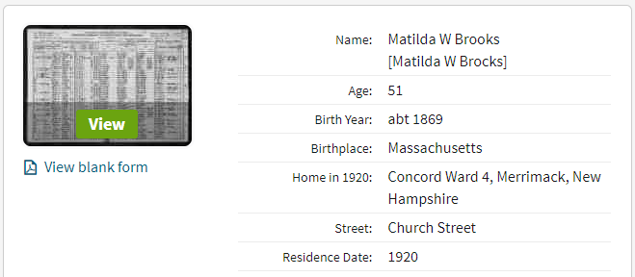
Verify your research
Always verify transcriptions with the original document
There are often errors in transcriptions

Slide 12
Organize your research
Paper, digital, or both?
Dependent on comfort level with technology
Paper
Paper lasts longer
Digital
Back up digital files to an external drive, USB, or cloud storage
LOCKSS Principle (Lots of Copies Keeps Stuff Safe)
Both
More work, but ensures against damage to physical files, computer failure, and changes in technology

Slide 13
Organize your research
Several charts available
Research trackers
Ancestral/Pedigree charts
Future generations should be able to understand your findings and where you obtained your information
Document your research
Download/print all original documents
Capture all information about a source

Slide 14

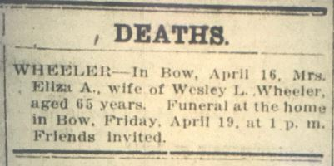
Organize your Research
Obituary with no supplemental information:
Obituary with masthead, date, and page number:

Slide 15
Organize your research
Create your own filing system
Organize by family names
Organize chronologically
Consistently print or copy on the same size paper

Slide 16
Organize your research
Find a safe storage place for your research
Avoid damp basements or attics
Keep materials out of and away from sunlight

Slide 17
Organize your research
Create narratives for each person
List facts and sources for each one
Create narratives for important artifacts/heirlooms

